Slide 1
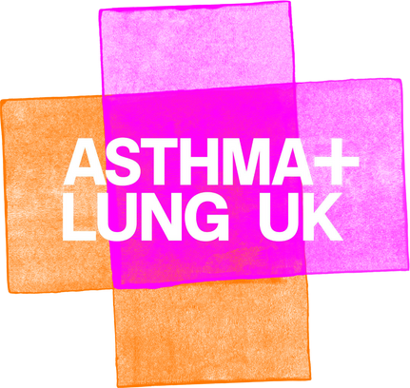

Slide 2


In this lesson, we'll be...
learning about what air pollution is and what causes air pollution.
finding out where air pollution is worst.
using maps and legends (keys).
using special vocabulary.
Keywords
air pollution
pollutants
air quality
emissions
oxygen
carbon dioxide
lead
methane
harmful substances
ozone
transport
manufacturing
fossil fuels
industrial
agriculture and farming
urban
rural

Slide 3
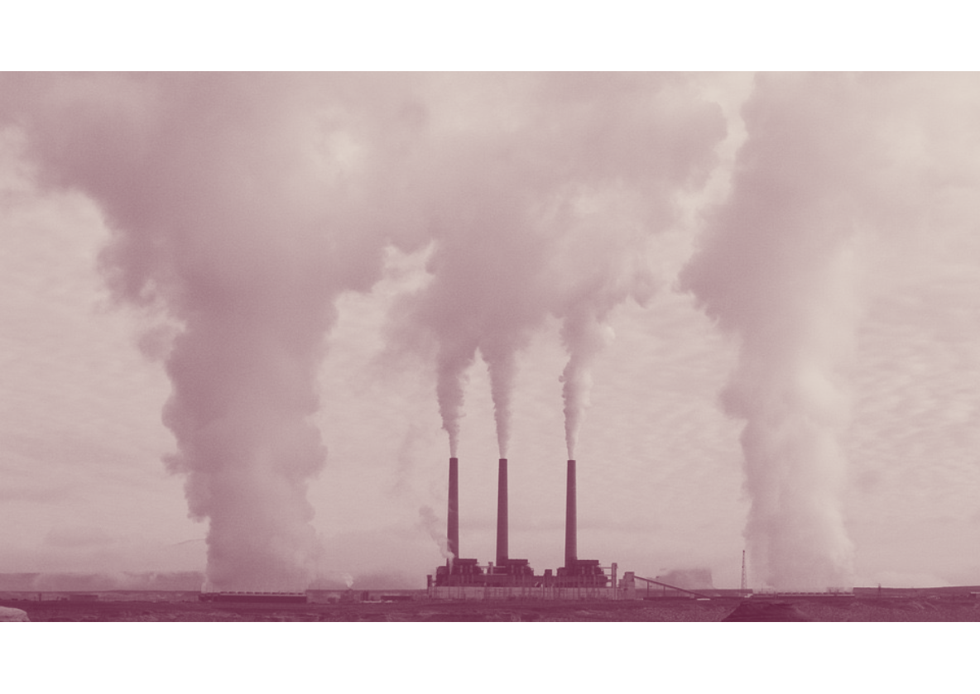
What is air pollution?
Have you heard the term air pollution before?
Do you know what it means?
Air pollution means air that contains substances that could be harmful to humans, animals and plants.
Harmful substances include gases, chemicals and particles. These can come from natural sources (such as volcanoes or wildfires) or they can come from human-made sources (such as cars and factories).

Slide 4




Different types of air pollution
Let's play a matching game!
A natural greenhouse gas, one part carbon and two parts oxygen.
Nitrogen dioxide
A gas made up of one part sulphur and two parts oxygen.
Carbon dioxide
A gas made up of one nitrogen atom and two oxygen atoms.
Sulphur dioxide

Slide 5




Different types of air pollution
Let's play a matching game!
A gas made up of one carbon atom and one oxygen atom.
Particulate matter
Tiny, microscopic particles of solids or droplets of liquids.
Ozone
Ground-level ozone
A gas made up of three oxygen atoms.
Ozone at ground level, otherwise known as smog.
Carbon monoxide

Slide 6
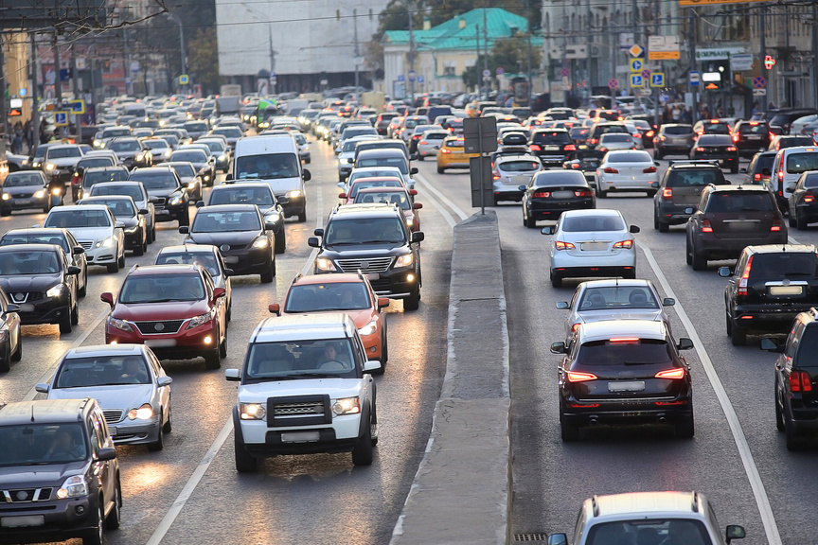
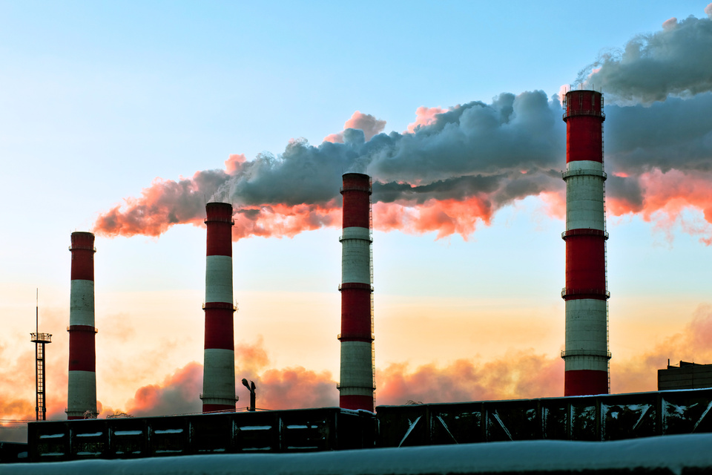
Where do pollutants come from?
Take a look at these photos and see if you can identify the sources of pollutants (or harmful substances) found in the air.
Road vehicles emit a range of pollutants, including lead, carbon dioxide, carbon monoxide, nitrogen oxides and particulate matter.
Many factories burn fossil fuels like oil and natural gas to create energy (poser). Burning fossil fuels creates harmful gases, such as carbon monoxide, sulphur dioxide and nitrogen oxides.
Click on each image to find out about it.

Slide 7
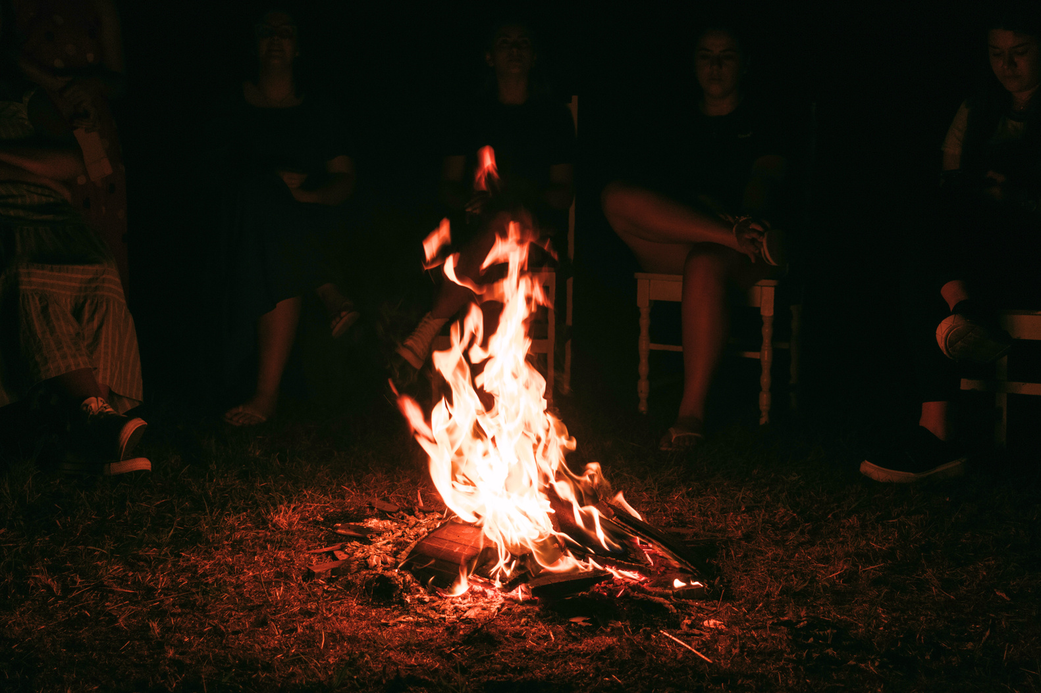
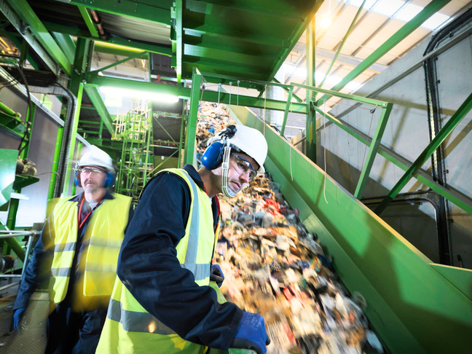
Where do pollutants come from?
Take a look at these photos and see if you can identify the sources of pollutants (or harmful substances) found in the air.
Smoke and fumes from bonfires can contain carbon monoxide, particulate matter and methane.
Recycling plants release lead fumes, carbon dioxide and sulphur dioxide into the air.
Click on each image to find out about it.

Slide 8
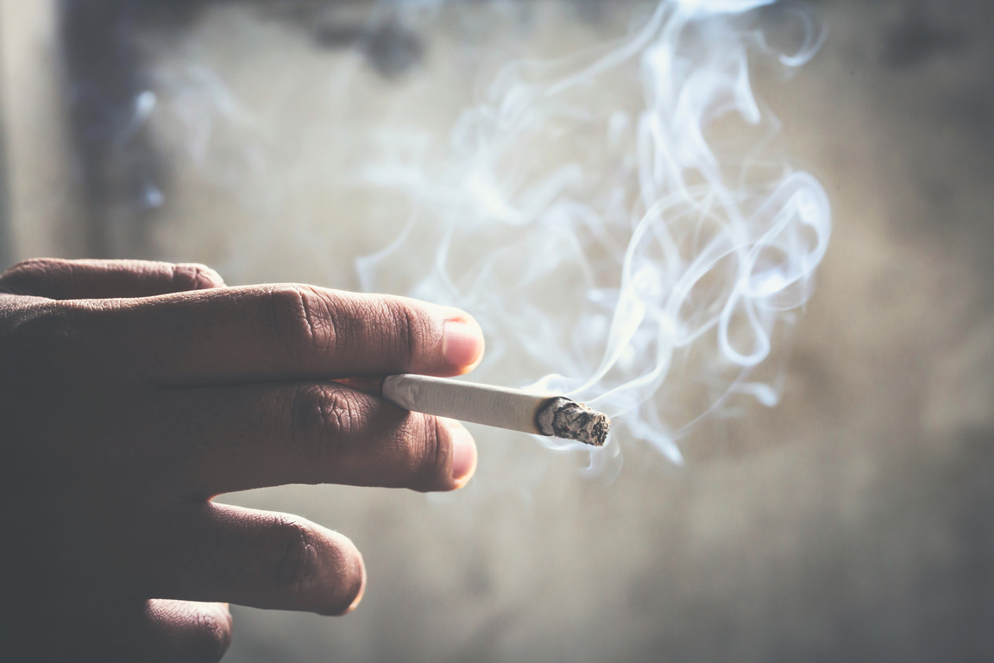
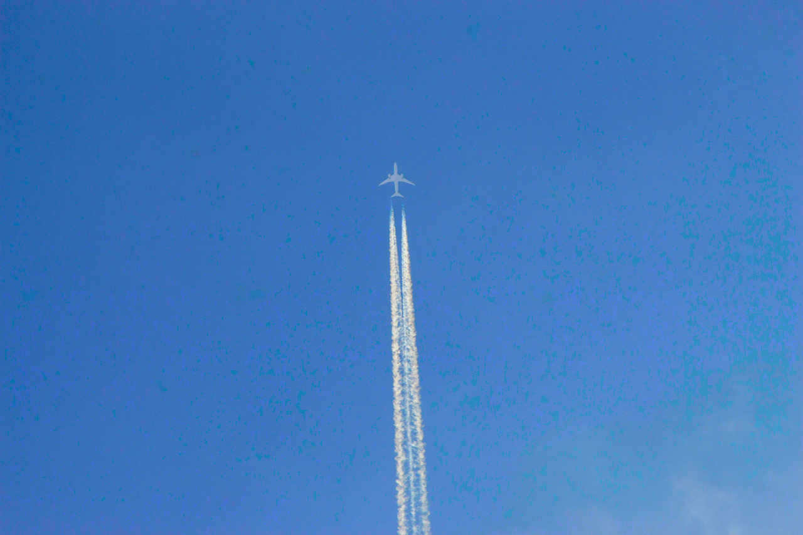
Where do pollutants come from?
Take a look at these photos and see if you can identify the sources of pollutants (or harmful substances) found in the air.
Cigarette smoke contains toxic pollutants including nitrogen oxides, carbon monoxide and hydrocarbons.
Aeroplanes burn fossil fuel which releases carbon dioxide and nitrogen oxides. Lead, ozone and particulate matter are also released.
Click on each image to find out about it.

Slide 9
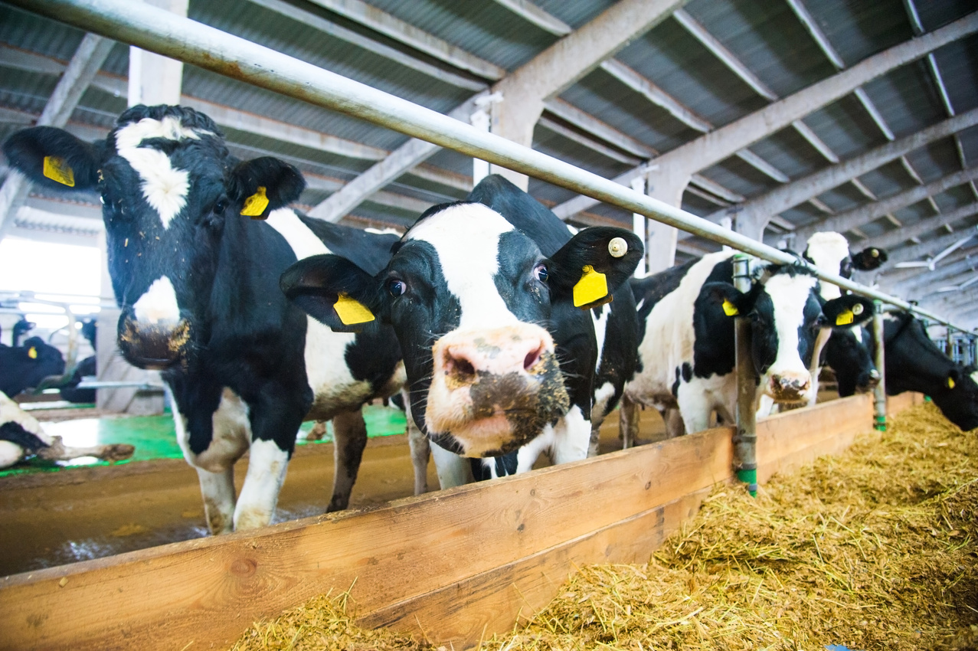
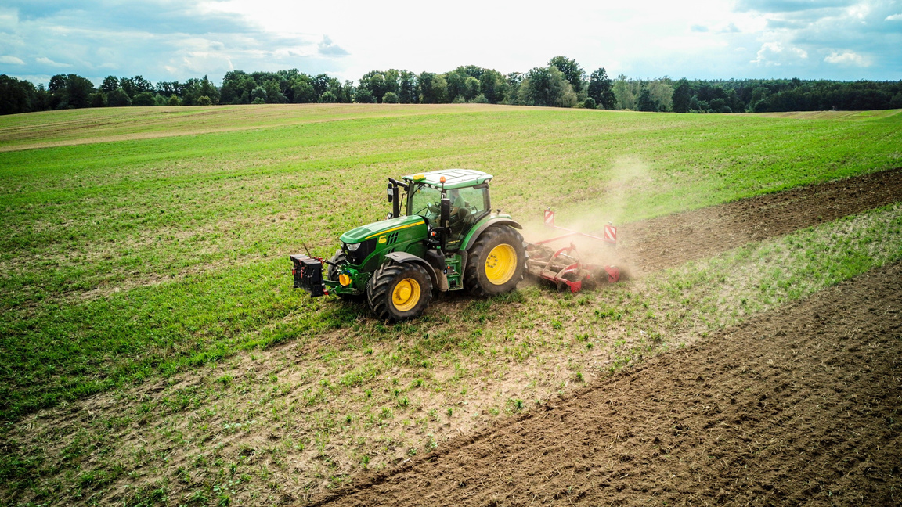
Where do pollutants come from?
Take a look at these photos and see if you can identify the sources of pollutants (or harmful substances) found in the air.
Dairy farms create methane, ammonia and carbon dioxide as they produce food for cattle and the cattle produce manure.
Farm vehicles emit pollutants like road vehicles. Crops are sprayed with pesticides to protect them from insects and weeds, but the pesticides create particulate matter and ground-level ozone.
Click on each image to find out about it.

Slide 10
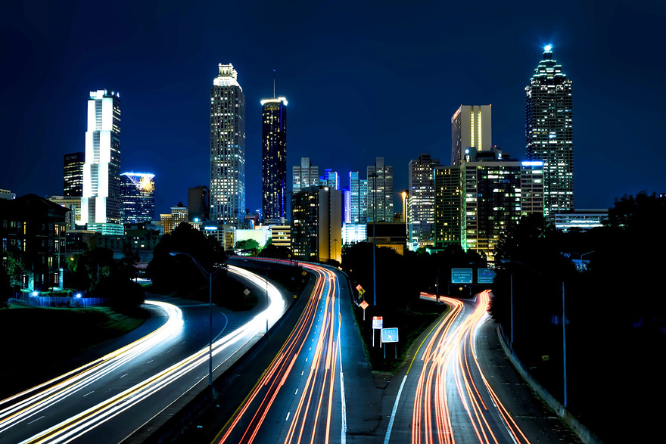
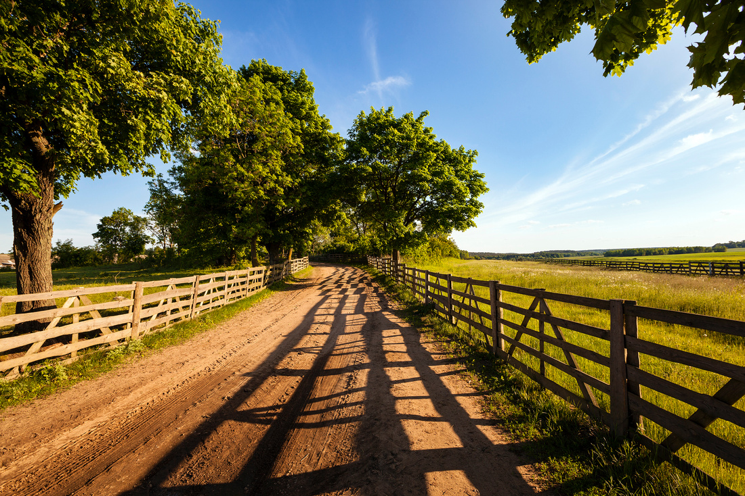
Areas with the most polluted air
Now you have learnt about the sources of harmful substances, can you suggest which areas are likely to have the highest levels of air pollution?
Urban areas are towns and cities. They are built-up areas, full of buildings and traffic. Lots of people live and work there.
Rural areas contain countryside, farms and villages. Fewer people live and work in these areas, and there is less traffic.

Slide 11
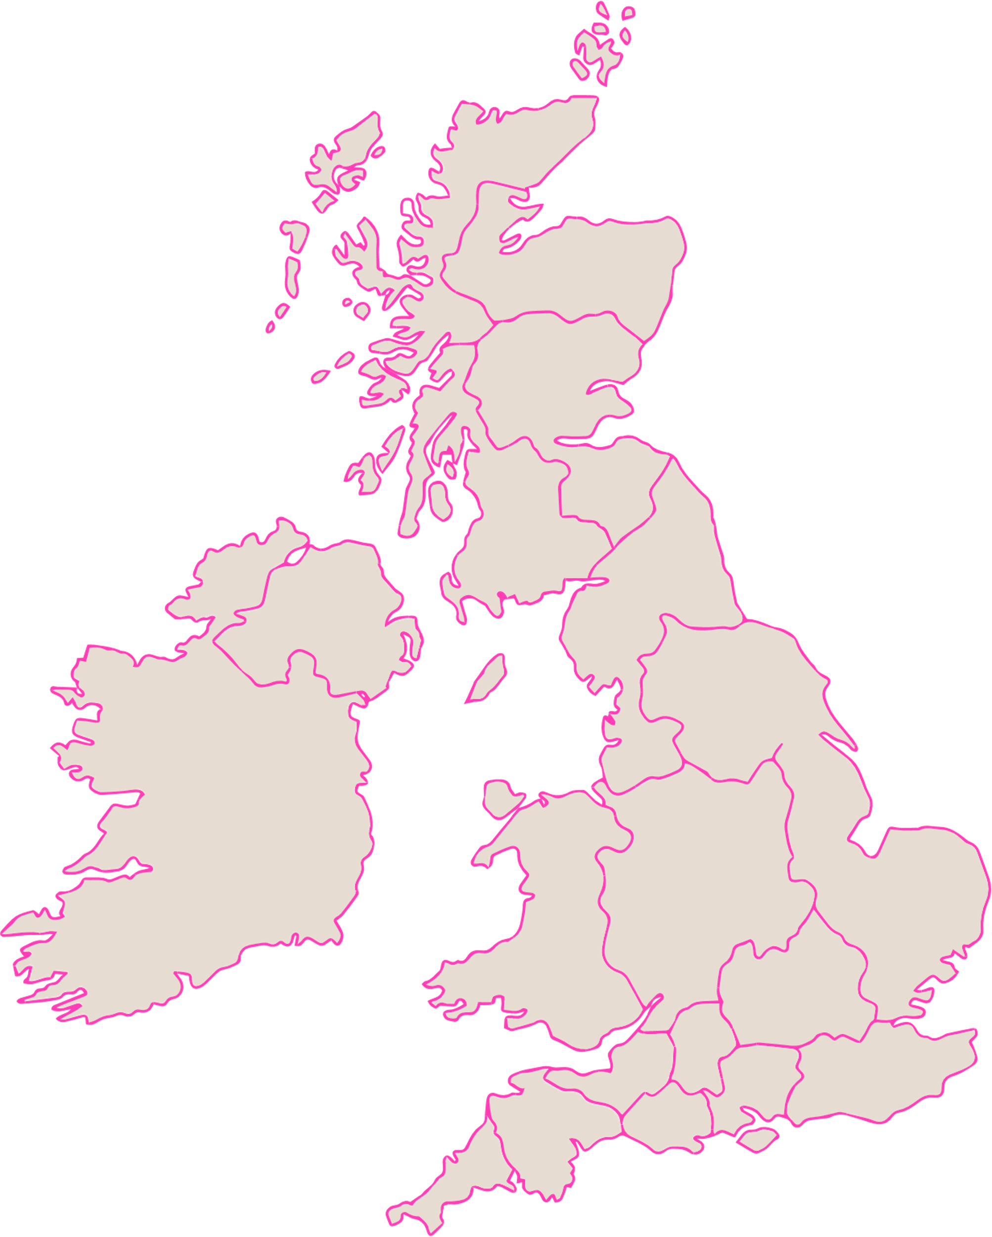
Air pollution in the UK
Can you name some cities and towns in the UK?
What do you think the air quality is like in these places?
Can you name any rural areas in the UK?
What might the air quality be like there?

Slide 12
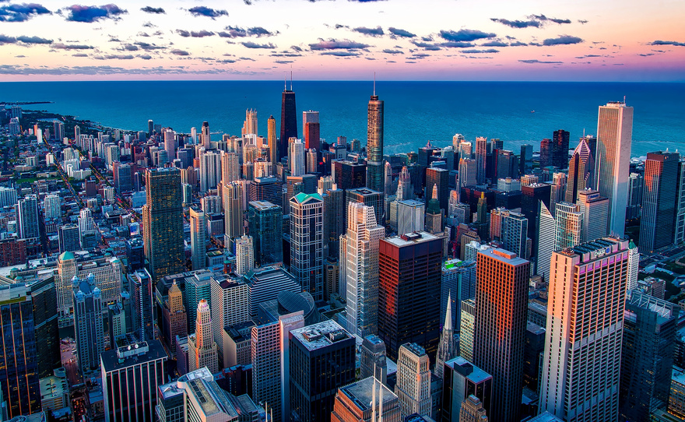
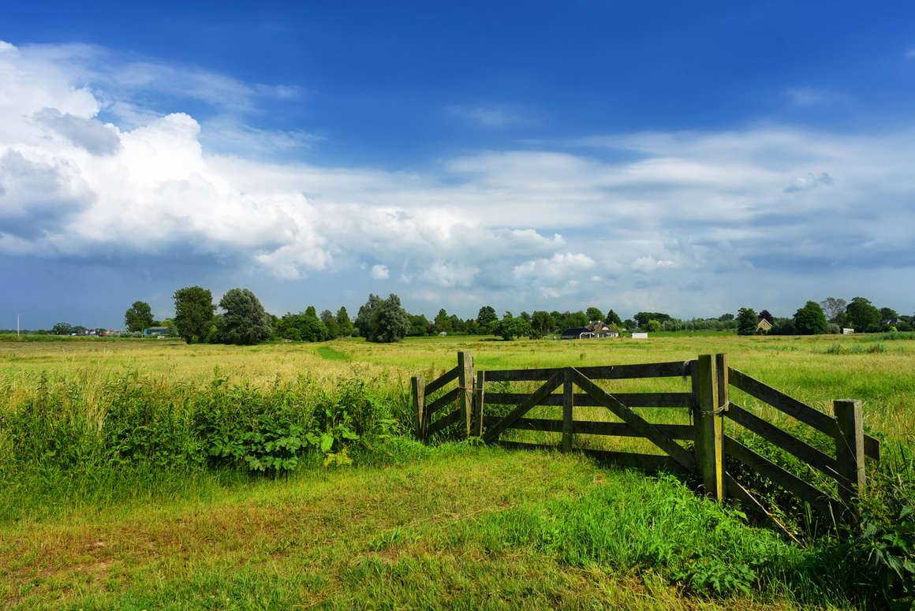
Measuring emissions
Emissions is another word for the gases and other substances that are released into the air.
Each type of emission can be measured.
Which types of emissions – or pollutants – do you think will be higher in urban areas?
Which types of emissions do you think will be higher in rural areas?

Slide 13
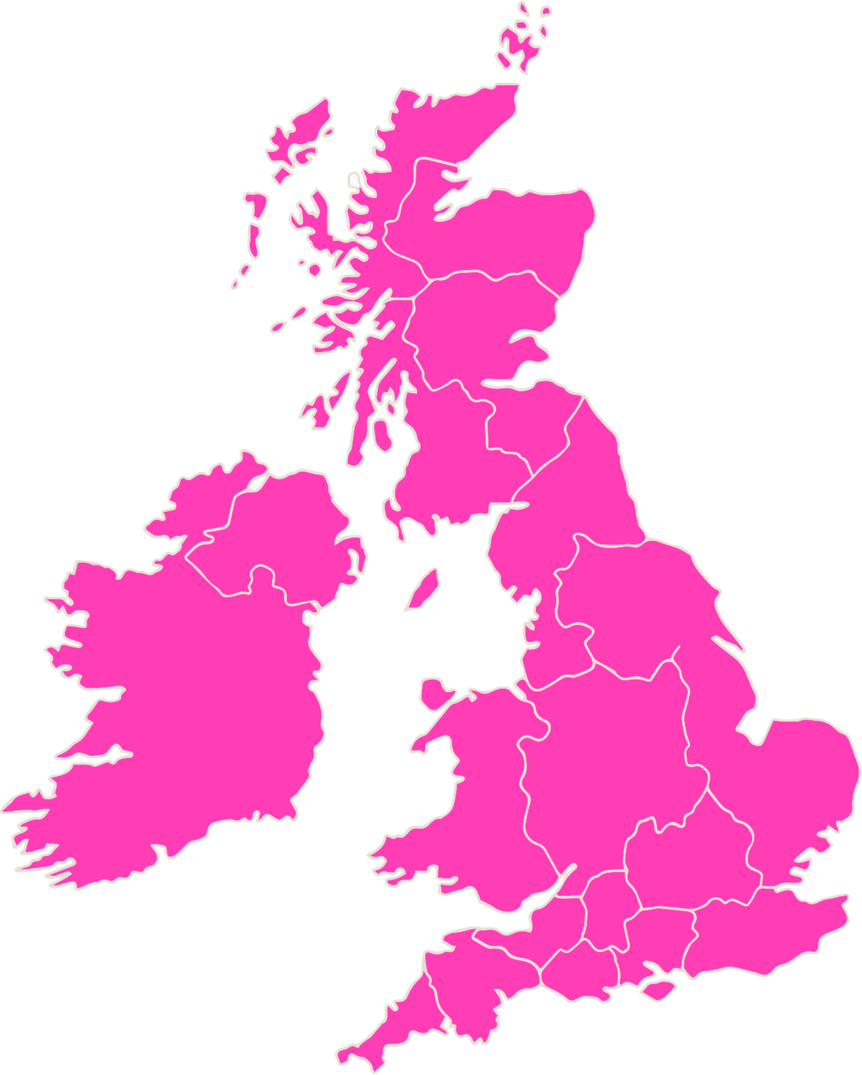
UK emissions
The UK government measure different emissions in all the different parts of the UK. Anyone who is interested can find out what the levels are using the UK Emissions Interactive Map.
Today, we are going to find out about some different types of emissions and where the levels of these emissions are the highest.

Slide 14
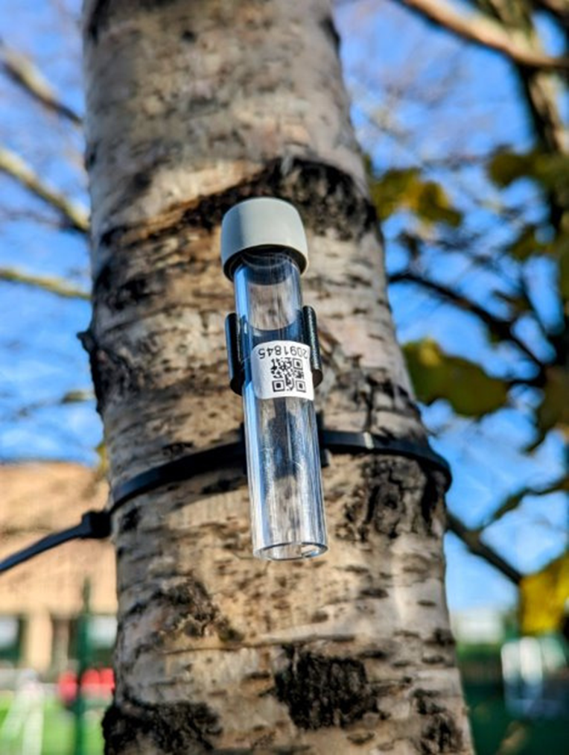
NO2 emissions
One pollutant that can be measured is Nitrogen Dioxide (NO2). It is released into the air when fuel is burned and can irritate our airways and cause breathing problems.
You might have seen one of these air monitors outside school. They are measuring NO2 levels.
Where do you think NO2 levels will be highest? Let's use the UK Emissions Interactive Map and see.

Slide 15
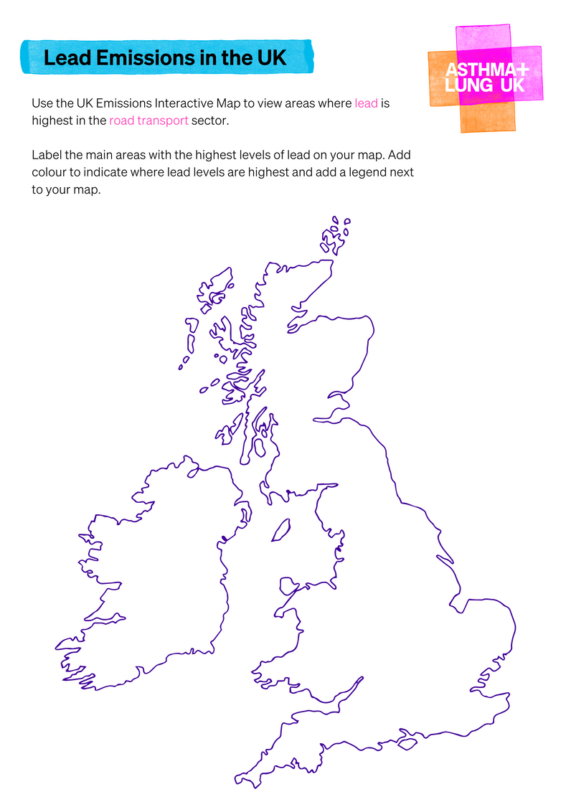
Lead levels in the UK
Next. We'll use the UK Emissions Interactive Map, to find out where lead pollutant levels are highest.
We'll need to use the filter on the left-hand side of the website:
We are going to select lead as a pollutant to view.
Then we are going to select road transport as a sector.
Now label some areas with high levels of lead on your map and use your coloured pencils to show areas with higher and lower levels.

Slide 16
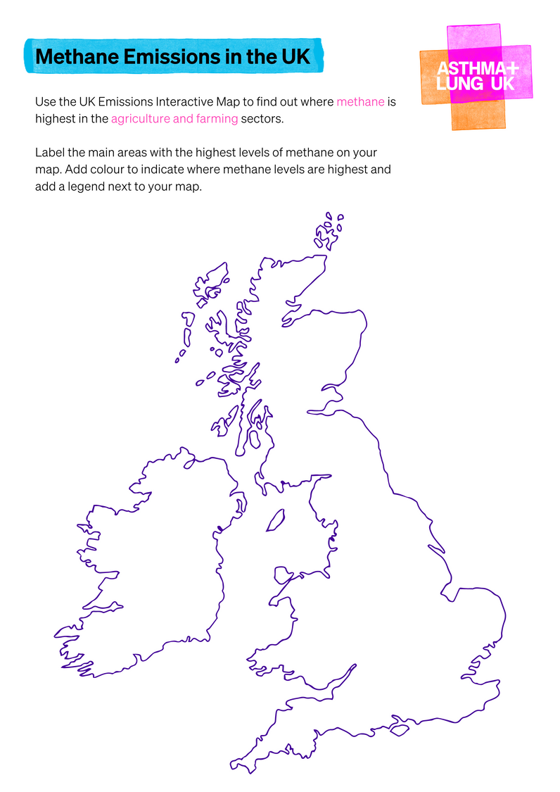
Methane levels in the UK
Now let's use the UK Emissions Interactive Map, to see where the highest levels of methane are. Methane is a gas that affects climate change.
We'll need to use the filter on the left-hand side of the website:
We are going to select methane as a pollutant to view.
Then we are going to select agricuture and farming as a sector.
Now label some areas with high levels of methane on your map and use your coloured pencils to show areas with higher and lower levels.

Slide 17
What have we learnt today?
Can you explain to your partner what air pollution is?
Can you remember two things that release harmful substances into the air?
Can you explain why urban areas have higher levels of many emissions than rural areas?

Slide 18
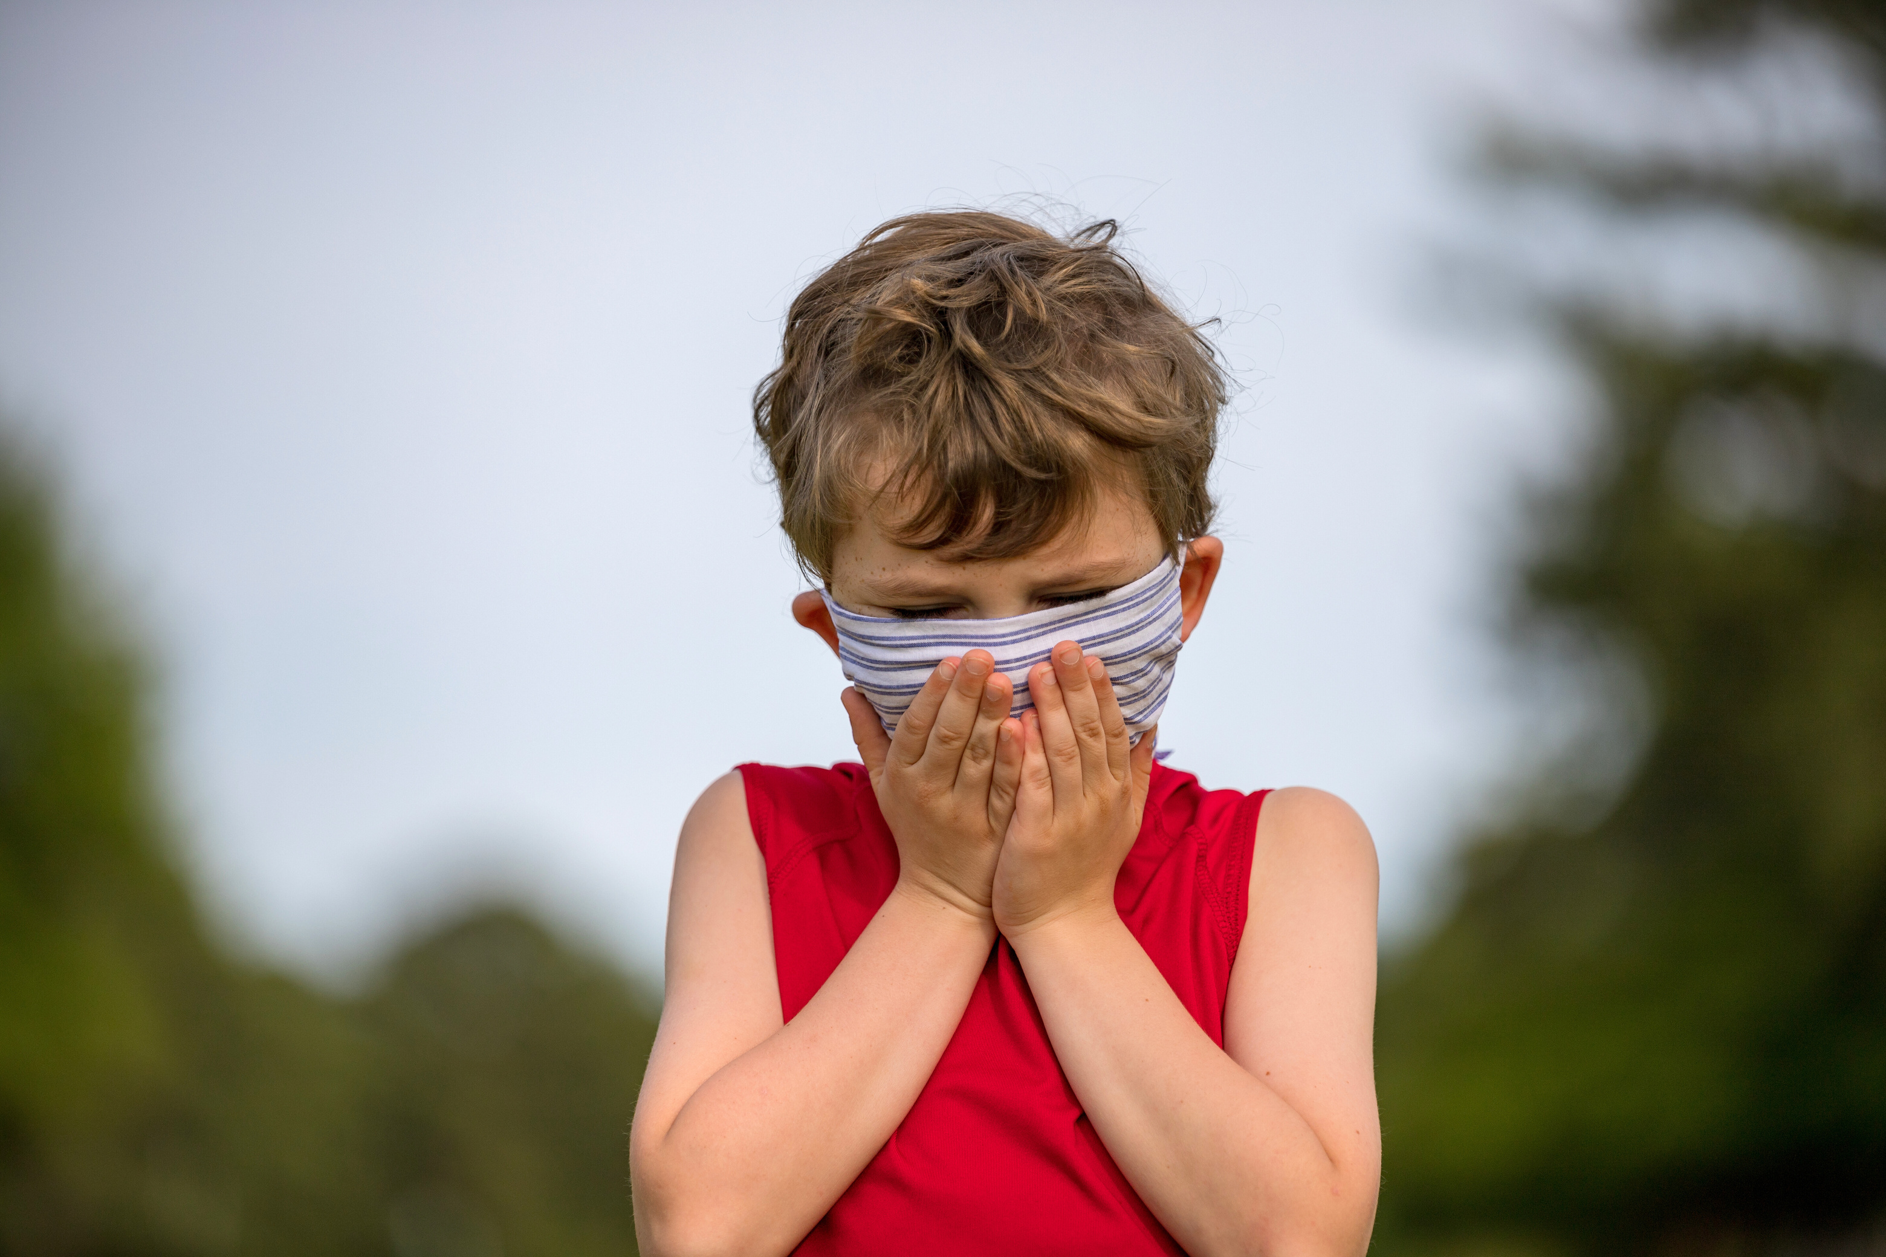
The air we breathe
When we breathe in polluted air, it can impact our health, especially people with breathing problems or lung conditions, like asthma.
When possible, we should try to avoid breathing in polluted air. You might see people wearing masks in busy cities, to protect themselves from the traffic fumes.

Slide 19

Calling for cleaner air
Today, we've learnt about air pollution and how it impacts our health and the environment.
In the UK alone, thousands of people are campaigning to demand change. Asthma + Lung UK and other charities are calling on the government to set clean air targets to tackle air pollution. By raising their voices, they hope we can work towards a better, cleaner future.

Slide 20
Breath is an inhalation, an exhalation. Breath is life.
We’re the UK’s lung health charity, fighting for your right to breathe.

